Slide 1
A Lightweight, Privacy-Preserving Offline Phishing Detection System Using Explainable URL-Based Analysis
Ahmad Marwan AlMaghaireh

Slide 2
Agenda
Brief introduction
Research Questions
Data collection (Primary and secondary)
Methodology
Main findings and results (Primary and secondary)
Recommendations

Slide 3
introduction
Phishing remains one of the most effective cyberattacks despite widespread browser security mechanisms
Many existing solutions rely on cloud-based analysis and reputation services
These approaches introduce privacy concerns, network latency, and dependency on external services
Additionally, intrusive pop-up warnings often lead to alert fatigue and are ignored by users
This research addresses both technical detection performance and user experience,
which leads to two core research questions

Slide 4
Research Questions
RQ1: Can a lightweight machine-learning model, trained only on
intrinsic URL features achieve high phishing detection accuracy while
running fully offline in real-time browser environments?
RQ2: Are inline underline-style phishing warnings perceived by
users as more usable, less intrusive, and
more privacy-preserving than traditional pop-up or blocking warnings?

Slide 5
Data collection :Primary Data
Primary data collected through an online survey using Google Forms
33 adult participants, all providing informed consent
Survey focused on:
Experience with phishing attempts
Perceptions of privacy and cloud-based analysis
Usability and intrusiveness of different warning mechanisms
All responses were anonymous and
quantitative (Likert-scale and multiple-choice)

Slide 6
Data collection : secondary Data
Secondary data obtained from the PhiUSIIL Phishing URL Dataset (2023)
Dataset contains approximately 235,000 URLs with 56 features
Binary classification: phishing vs legitimate URLs
Features include:
URL lexical and structural characteristics
Lightweight indicators computable without network access
External and oracle-based features were excluded to enforce offline operation

Slide 7

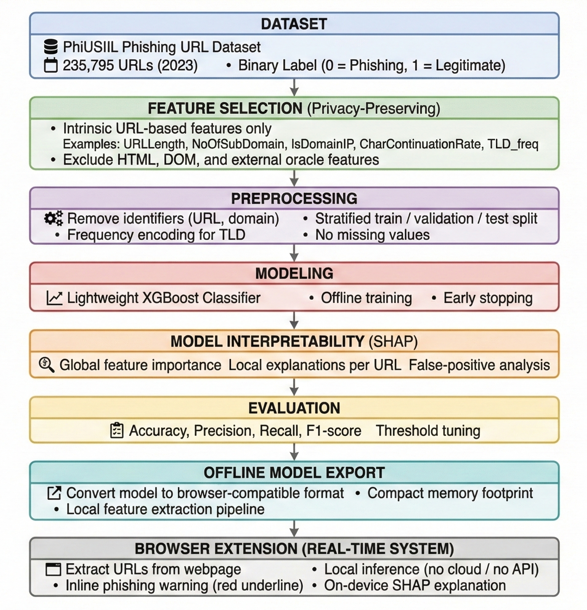
Methodology
The following figure illustrates the complete technical methodology adopted in this research, from data preprocessing and feature selection to model training, evaluation, explainability, and browser-based deployment.

Slide 8
Main findings and results : Primary Data
Strong user preference for privacy-preserving tools:
75.8% preferred offline analysis over cloud-based detection
High dissatisfaction with traditional warnings:
66.7% rated pop-up warnings as annoying or very annoying
Strong acceptance of inline warnings:
97% preferred underline-style warnings
Majority reported they would double-check underlined links

Slide 9



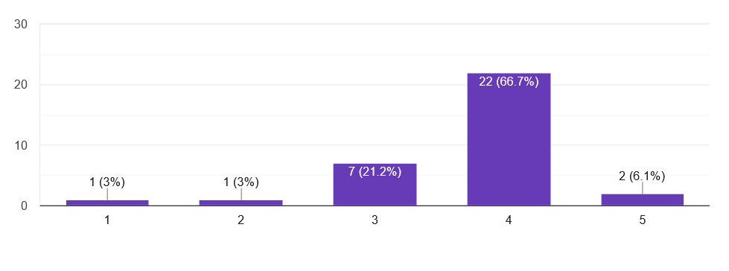


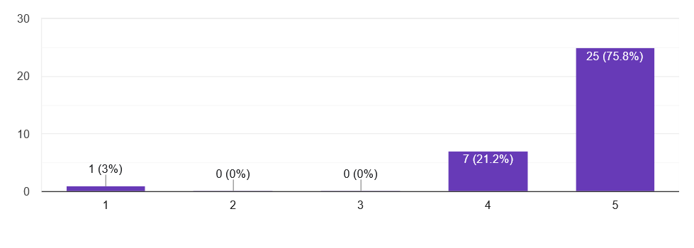
Main findings and results : Primary Data
Participant ratings of the intrusiveness of traditional security warnings
Participant ratings of the usefulness of inline underline warnings.

Slide 10
Main findings and results : secondary Data
A URL-only XGBoost model was trained and evaluated
Achieved approximately 99.93% accuracy at the balanced operating point
Both phishing miss rate and false-alarm rate remained below 0.1%
Inference completed in the millisecond range, supporting real-time browser execution
Results achieved without cloud services or external feature lookups

Slide 11
Main findings and results : secondary Data
Operating Policy | Threshold (P_legit) | Accuracy | Precision (Legit) | Recall (Legit) | F1-Score (Legit) | Phish Miss Rate | Legit False-Alarm Rate
Balanced (Min miss + false alarm) | 0.63 | 0.999279 | 0.999407 | 0.999333 | 0.999370 | 0.000792 | 0.000667
Low False Alarm (Miss ≤ 0.2%) | 0.30 | 0.998982 | 0.998519 | 0.999703 | 0.999111 | 0.001981 | 0.000297
Low Miss (False Alarm ≤ 0.05%) | 0.48 | 0.999237 | 0.999111 | 0.999555 | 0.999333 | 0.001189 | 0.000445

Slide 12
Research Questions: Answers
Answer to RQ1: The results demonstrate that a lightweight, fully offline URL-based model can achieve very high detection performance while remaining suitable for real-time, browser-native deployment.
Answer to RQ2: Survey findings indicate that users clearly prefer inline underline warnings, perceiving them as less intrusive and more usable than traditional pop-up alerts, while also aligning with privacy expectations.

Slide 13
Recommendations
Adopt offline, URL-only phishing detection architectures to preserve user privacy
Prioritise lightweight models that can run directly in the browser without latency
Replace intrusive pop-up warnings with subtle inline visual indicators
Provide simple, local explanations to improve trust and understanding
Allow user control mechanisms such as local allowlists to handle false positives

Slide 14
Conclusion
High phishing detection accuracy can be achieved without cloud dependence
Privacy preservation and usability significantly influence user trust
Combining lightweight models, explainability, and non-intrusive warnings leads to more deployable and user-accepted security systems

